Slide 1
Synnovis equipment upgrade: Abbott Alinity key biochemistry test changes at KCH
January 2025

Slide 2
Notable test changes
Equipment change | Insulin
Albumin | LH
Bile acids | Lipase
CA125 | Progesterone
CA19-9 | Prolactin
Caeruloplasmin | PTH
Cortisol | Troponin
C-peptide | Transferrin
Free T3 | TSH
Free T4 | Urine total protein
Note above hyperlinks only work in presentation mode

Slide 3
Equipment change
Current analyser manufacturer is Roche across both DH and PRUH biochemistry laboratories
New analyser manufacturer is Abbott
Align methodologies across Synnovis as equipment has been live at GSTT since November 2022 and Synnovis Hub since April 2024
A number of tests are not comparable between Roche and Abbott
Multiple reference ranges will be changing to reflect this
Some tests will be changing methodology:
Troponin T will be replaced with Troponin I
Albumin will now be measured using the bromocresol purple (BCP) method, which does not overestimate albumin compared with the previous bromocresol green (BCG).
Transferrin will now be measured (reported in g/L) instead of total iron binding capacity (TIBC). Transferrin saturation (TSat) will still be calculated but using the transferrin measurement instead of the TIBC calculation.
Return to test list slide

Slide 4
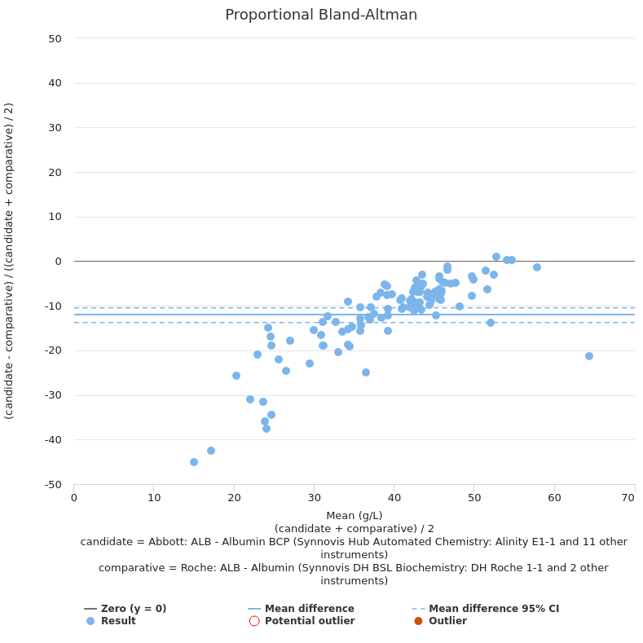
Albumin
Mean negative bias -12%
Bias increases as concentration decreases
Abbott bromocresol purple (BCP) vs Roche bromocresol green (BCG) doesn’t overestimate albumin
Recalculated adjusted calcium equation
New reference ranges:
Test | Age | Roche | Abbott
Albumin (g/L) | 0 - 14d |  | 28 - 41
 | 0 - 1m | 28 - 50
 | 1m+ | 35 - 50
 | 15d - 1y |  | 25 - 46
 | 1 - 8y |  | 35 - 45
 | 8 - 15y |  | 37 - 47
 | 15 - 19y |  | Male: 38 - 50 Female: 35 - 49
 | 19y+ |  | 31 - 45
Return to test list slide

Slide 5
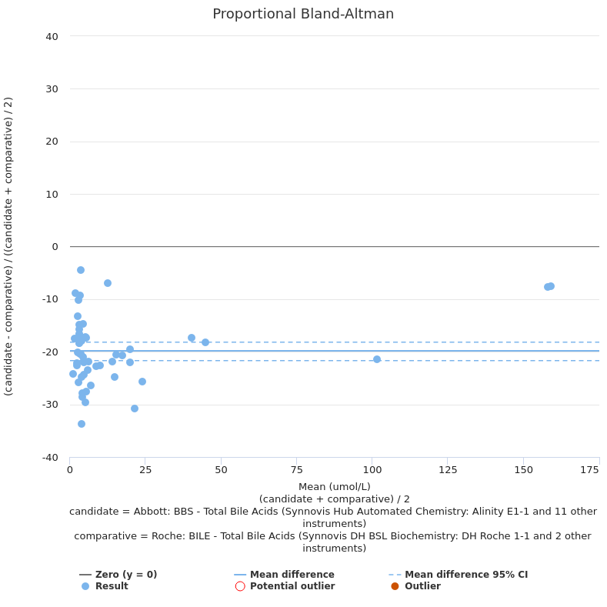
Bile acids
Mean negative bias -20%
New reference range:
Test | Roche | Abbott
Bile acids (µmol/L) | 0 - 14 | 1.0 - 6.0
Return to test list slide

Slide 6
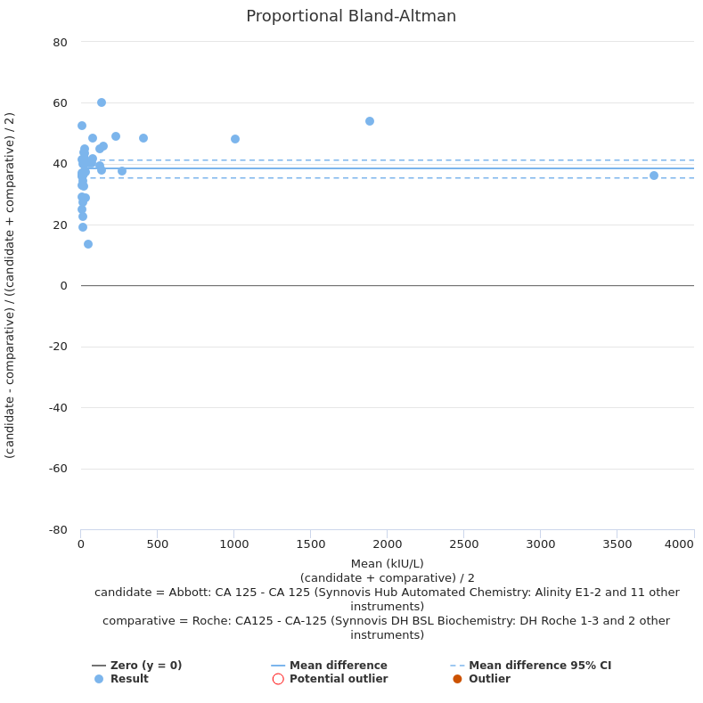
CA125
Mean positive bias +38%
NOT trendable to previous Roche assay
New test code breaks trend in Epic
Reference range – no change
Return to test list slide

Slide 7
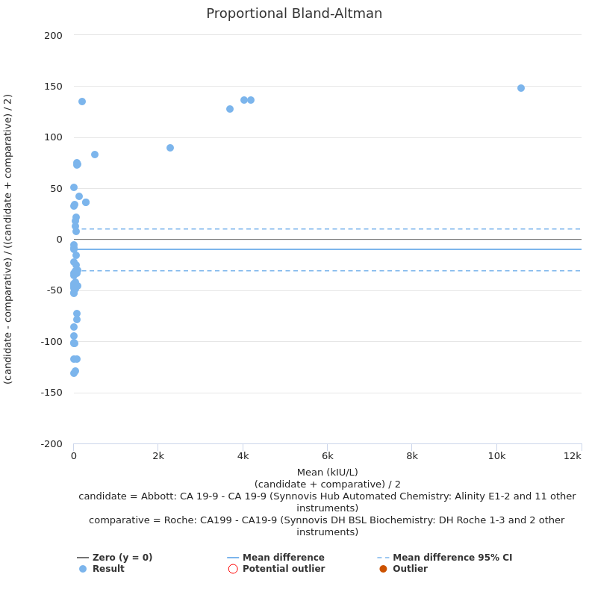
CA19-9
Variable bias:
<100 kIU/L little comparability
>100 kIU/L large positive bias (>100%)
NOT trendable to previous Roche assay
New test code breaks trend in Epic
Reference range – no change
Return to test list slide

Slide 8
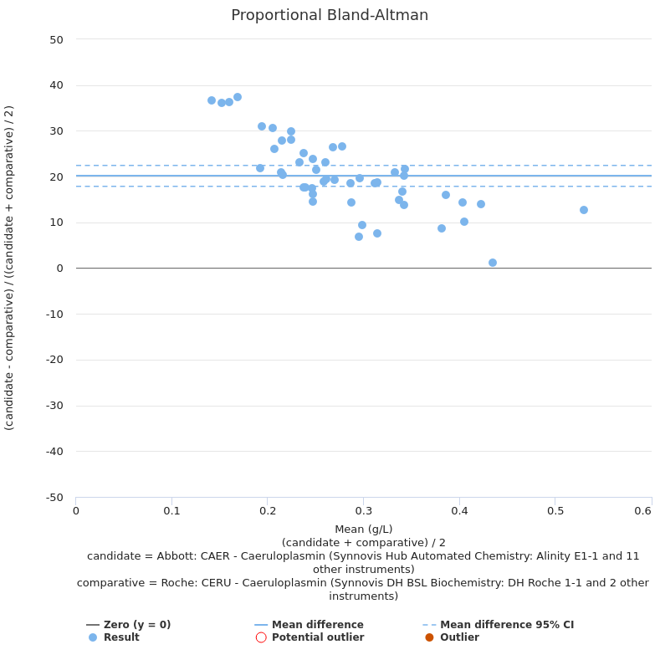
Caeruloplasmin
Mean positive bias +20%
Bias increases at lower concentration
New reference range:
Test | Roche | Abbott
Caeruloplasmin (g/L) | Male 0.15 - 0.30 Female 0.16 - 0.45 | 0.20 - 0.60
Return to test list slide

Slide 9
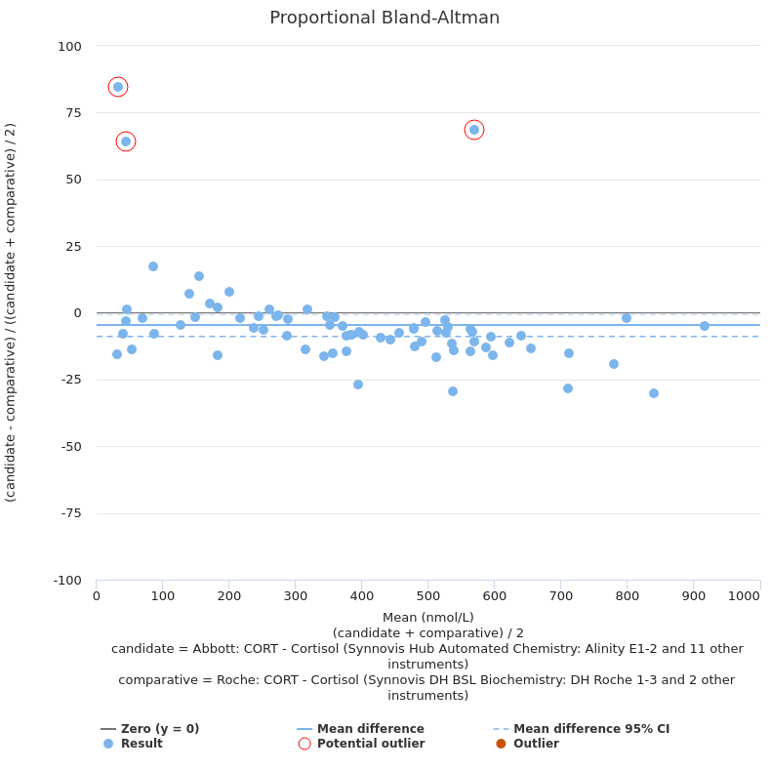
Cortisol
Negative bias above ~350 nmol/L of approximately -10%
Short synacthen test interpretation changes. Cut offs at 30 and 60 min:
Adequate >420 nmol/L
Equivocal 370 – 420 nmol/L
Fail <370 nmol/L
New reference range:
Test | Roche | Abbott
Cortisol (nmol/L) | 133-537 (06:00-10:00) 68-327 (16:00-20:00) | 102-535 (before 10 am) 80-477 (after 5 pm)
Return to test list slide

Slide 10
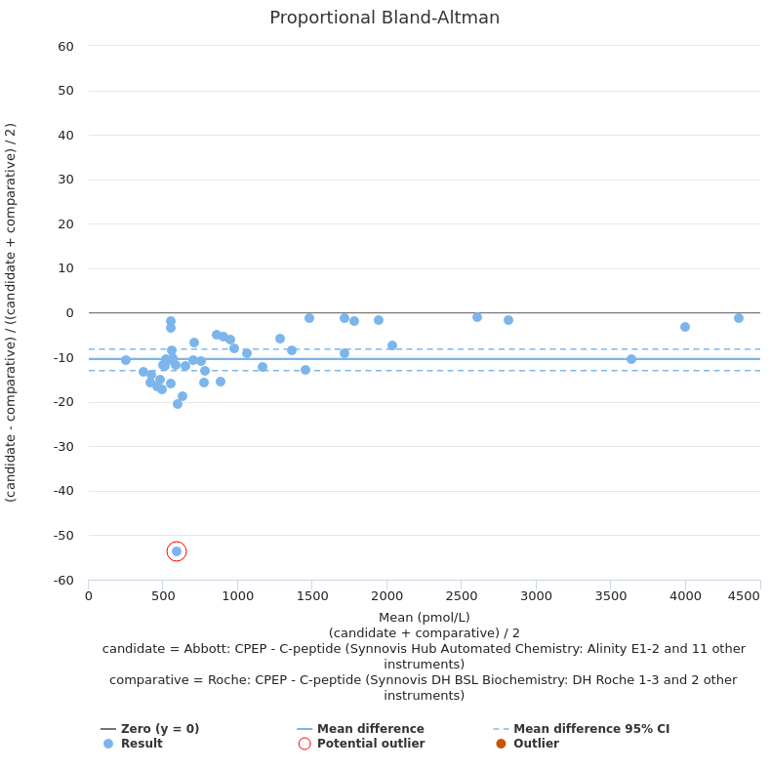
C-peptide
Mean negative bias -10%
New reference range:
Test | Roche | Abbott
C-peptide (pmol/L) | 370 - 1470 | 258 - 1718
Return to test list slide

Slide 11
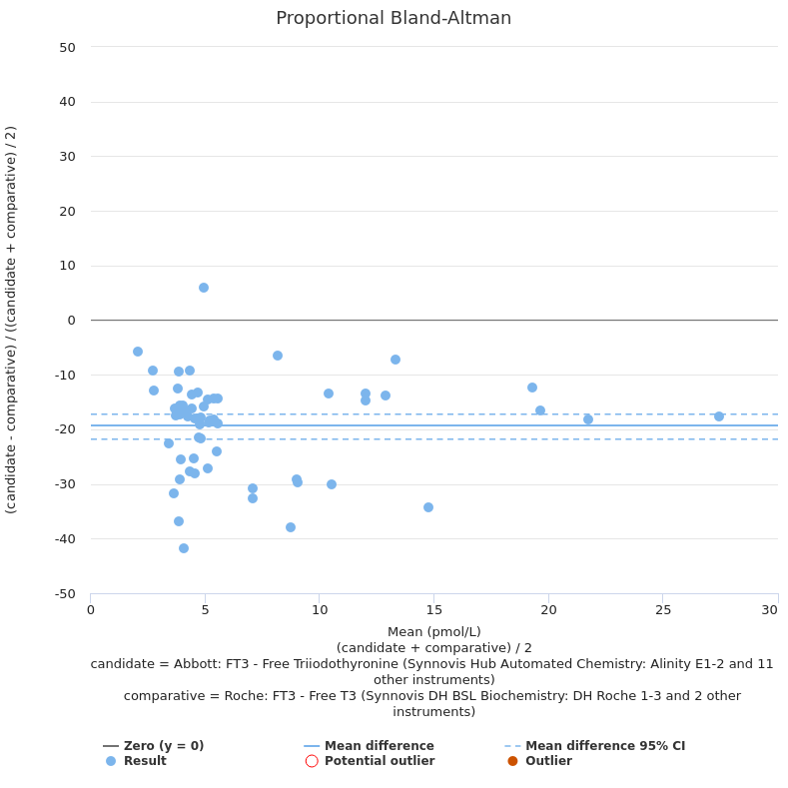
Free T3
Mean negative bias -19%
New reference range:
Test | Roche | Abbott
FT3 (pmol/L) | 3.1 - 6.8 | 2.4 - 6.0
Return to test list slide

Slide 12
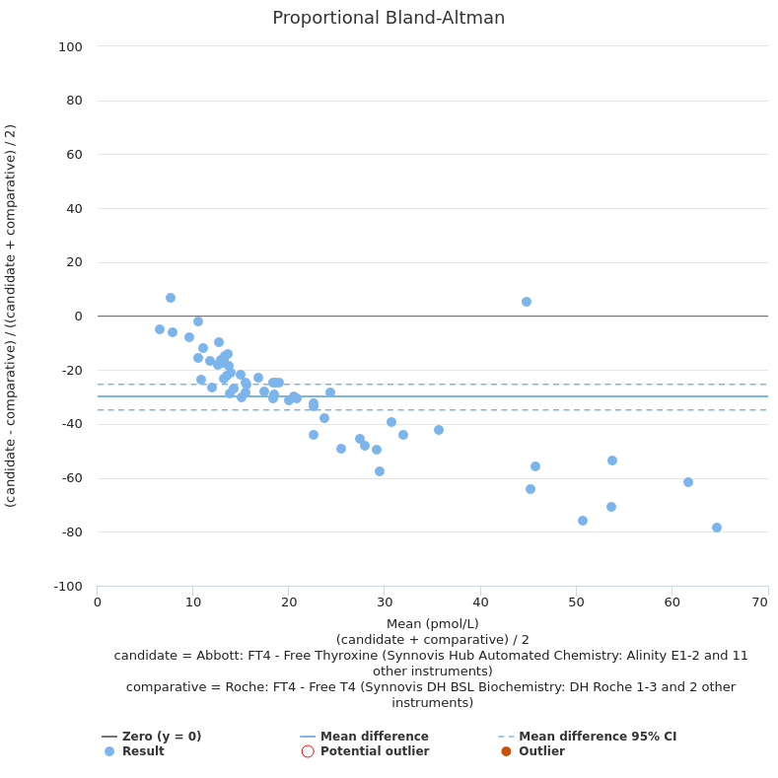
Free T4
Mean negative bias -30%
Percentage bias increases with concentration
Assay design less susceptible to falsely raised results
New reference range:
Test | Roche | Abbott
FT4 (pmol/L) | 11.0 - 21.2 | 9.0 - 19.1
Return to test list slide

Slide 13
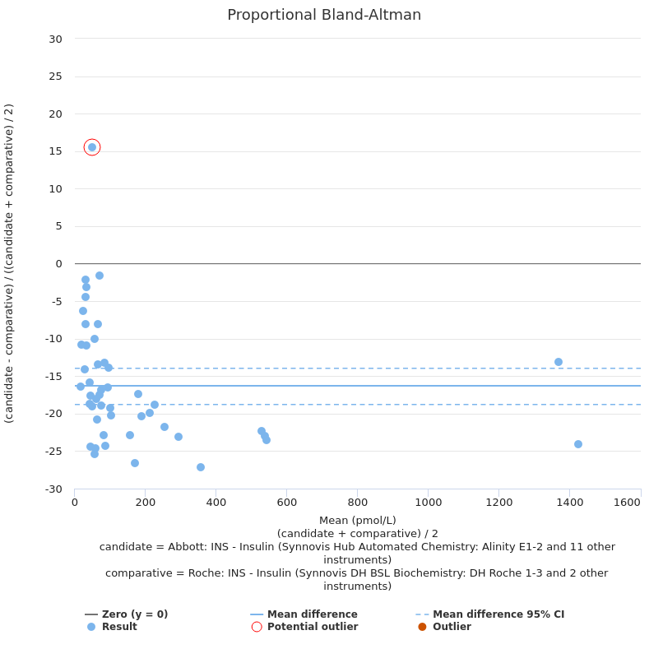
Insulin
Mean negative bias -16%
Will cross-react with exogenous insulins to an unknown extent
No reference range provided – interpret in light of glucose concentration
Return to test list slide

Slide 14
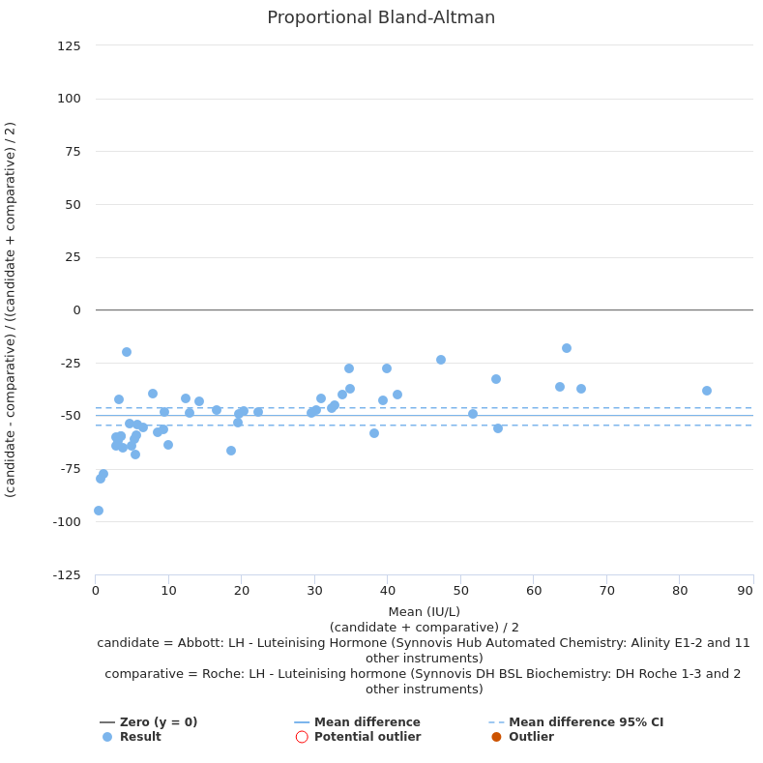
LH
Mean negative bias -50%
New reference ranges:
Test | Sex | Roche | Abbott
LH (IU/L) | Female | 2.4-12.6 Follicular 14.0-95.6 Mid-cycle 1.0-11.4 Luteal 7.7-58.5 Post-menopause | 1.8-11.8 Follicular 7.6-89.1 Mid-cycle 0.6-14.0 Luteal 5.2-62.0 Post-menopause
 | Male | 1.7 - 8.6 | 0.6 - 12.1
Return to test list slide

Slide 15
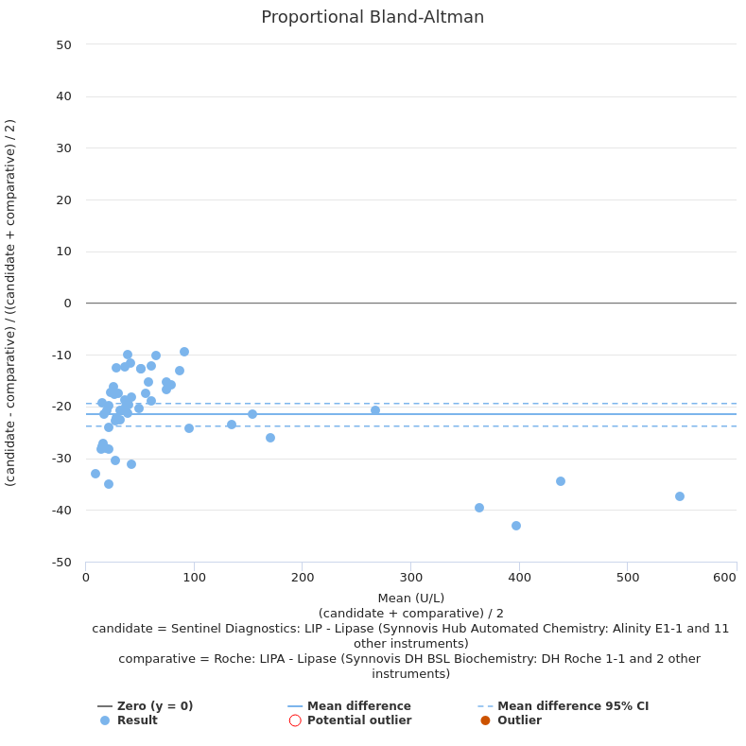
Lipase
Mean negative bias -21%
New reference range doesn't account for bias:
Test | Roche | Abbott
Lipase (U/L) | 13 - 60 | ≤60
Return to test list slide

Slide 16
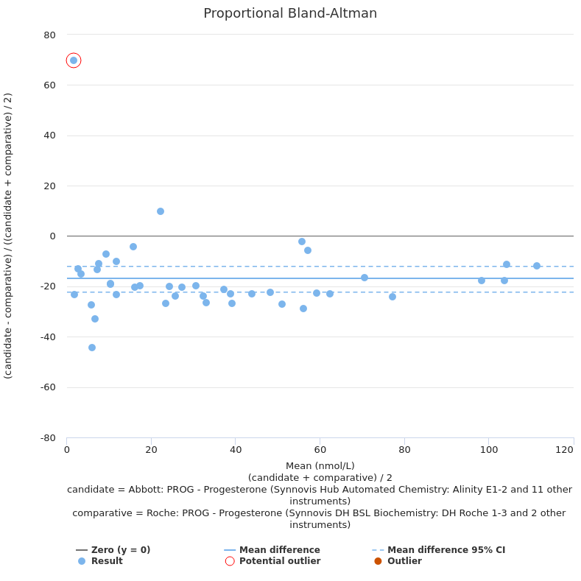
Progesterone
Mean negative bias -17%
New reference ranges:
Test | Sex | Roche | Abbott
Progesterone (nmol/L) | Female | Follicular < 0.7, Ovulatory <13.3, Luteal 13.1-46.3, Post-menopause < 0.6 | Follicular <1.6, Luteal 3.8-50.6, Post-menopause <1.6
 | Male | <0.6 | <1.6
Return to test list slide

Slide 17
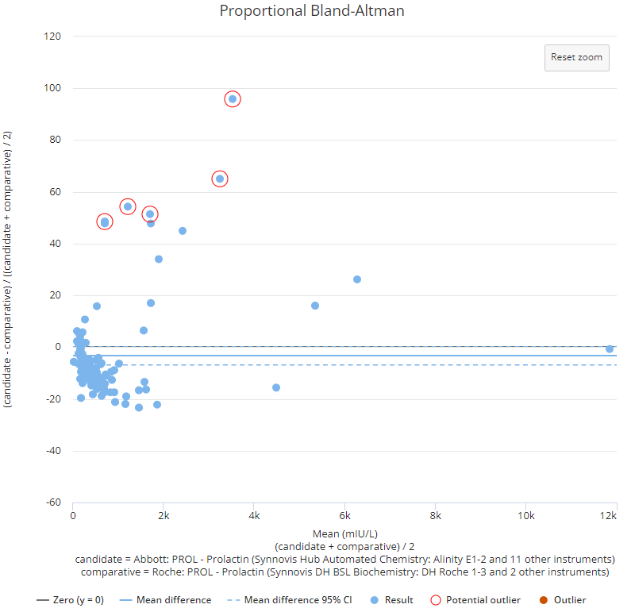
Prolactin
Overall negative bias approximately up to –20%
Greater cross-reactivity with macroprolactin
New reference range:
Test | Sex | Roche | Abbott
Prolactin (mIU/L) | Female | 102 - 496 | 109 - 557
 | Male | 86 - 324 | 73 - 407
Return to test list slide

Slide 18
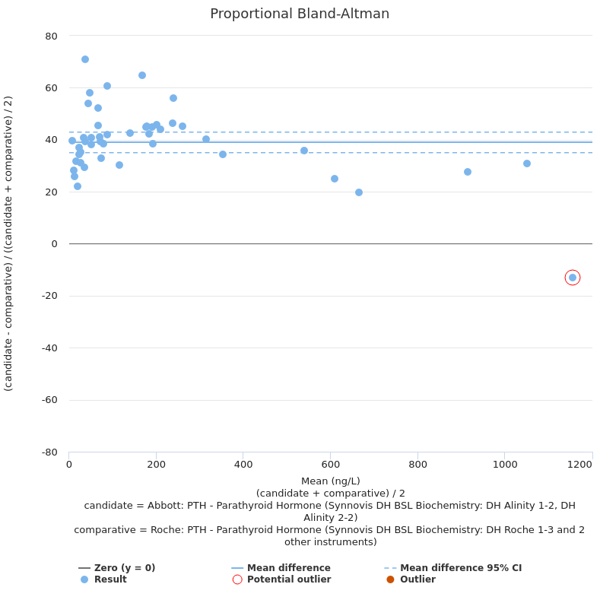
PTH
Mean positive bias +39%
Change in reference range doesn't account for bias
New reference range:
Test | Roche | Abbott
PTH (ng/L) | 15 - 65 | 15 - 68
Return to test list slide

Slide 19
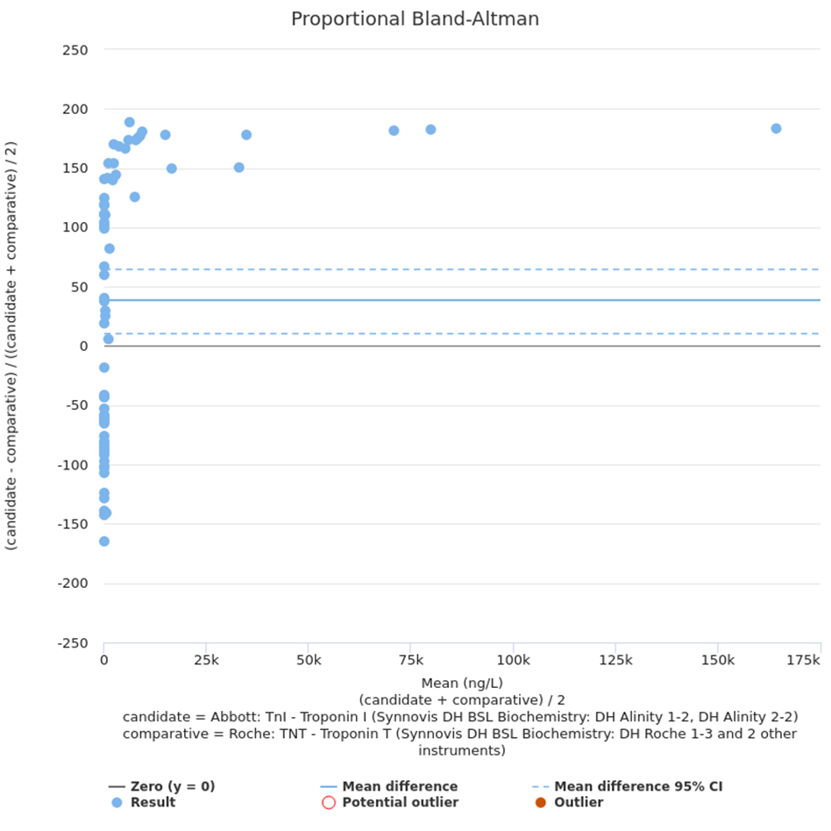
Troponin
Move from Troponin T to Troponin I
Results are not comparable:
<100 ng/L little comparability
>100 ng/L large positive bias (>100%)
New KCH chest pain protocol
Reference ranges:
Test | Age | Male | Female
Troponin I (ng/L) | <6m | ≤56
 | 6m-19y | ≤6
 | 19+ | <35 | <16
Return to test list slide

Slide 20
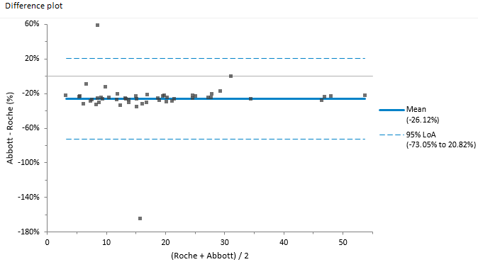
Transferrin
TSat (%) mean negative bias -26%
Now measured (reported in g/L) instead of total iron binding capacity (TIBC).
Transferrin saturation will be calculated but using the transferrin measurement instead of the TIBC calculation.
No change to TSat reference range
Return to test list slide

Slide 21
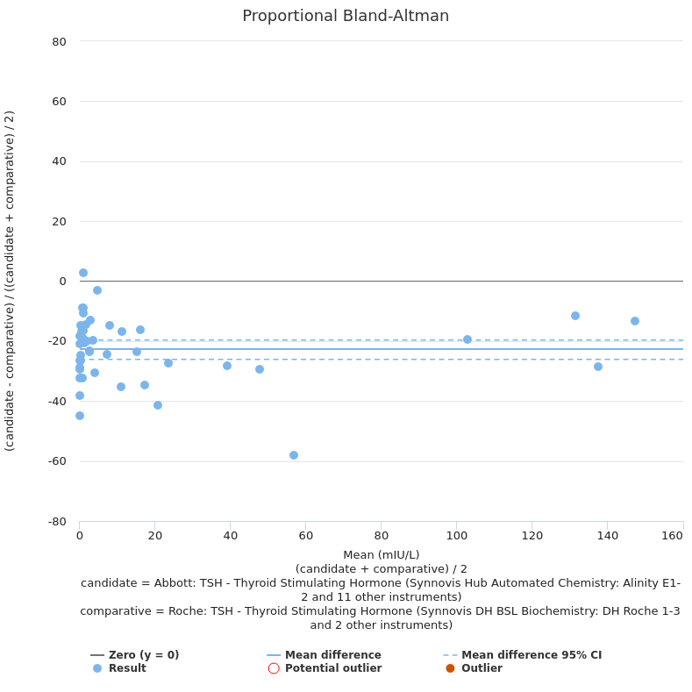
TSH
Mean negative bias -23%
New reference range:
Test | Roche | Abbott
TSH (mIU/L) | 0.27 - 4.20 | 0.35 - 4.94
Return to test list slide

Slide 22
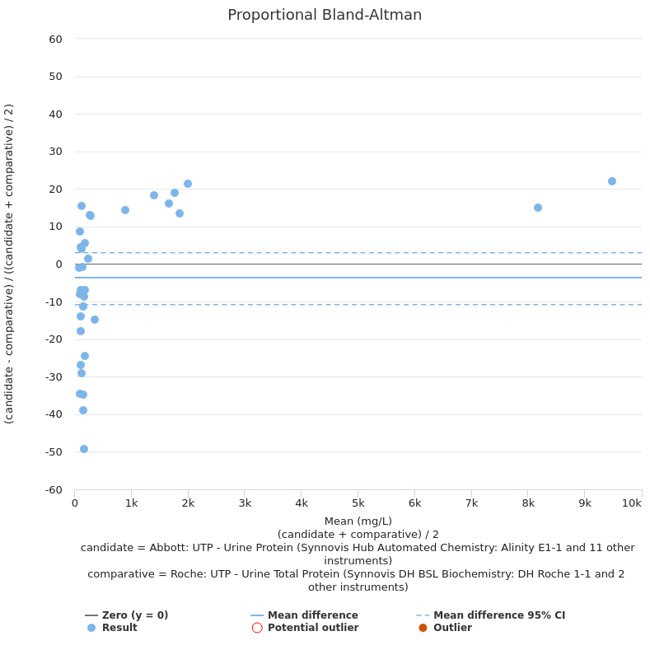
Urine total protein
Variable bias:
No overall bias observed <200 mg/L
Large positive bias ~+20% observed >200 mg/L
No change in reference range
Return to test list slide

